Slide 1
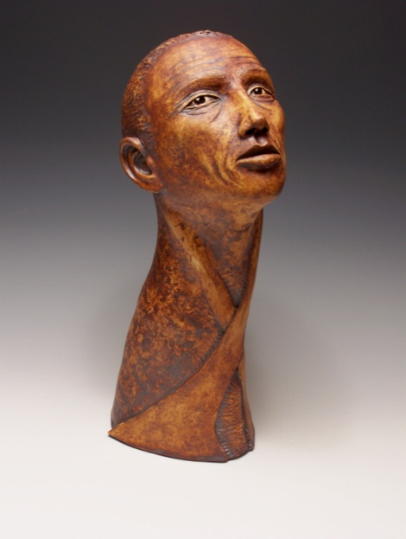
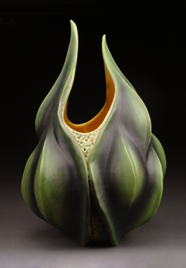
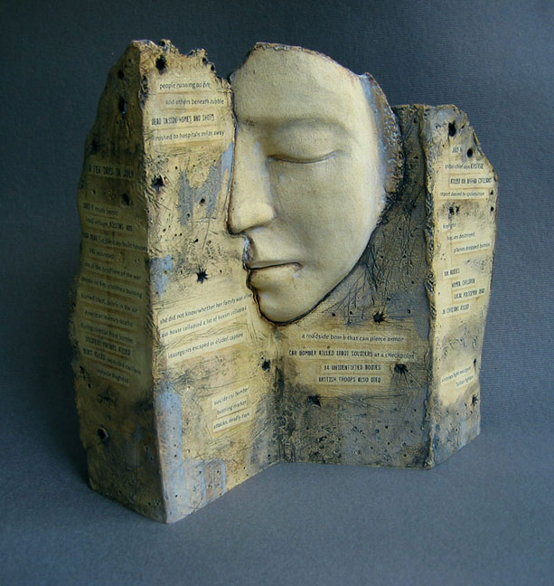
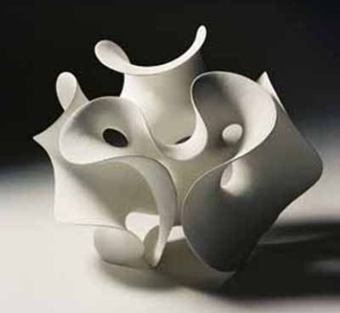
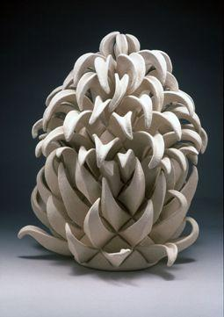
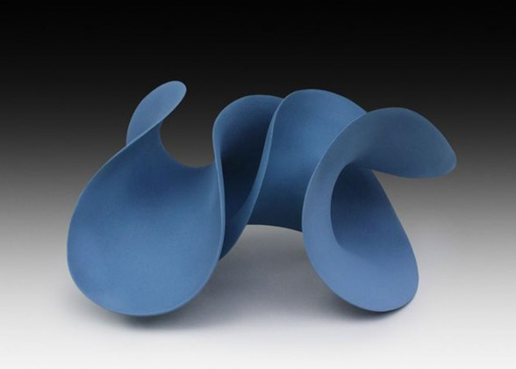
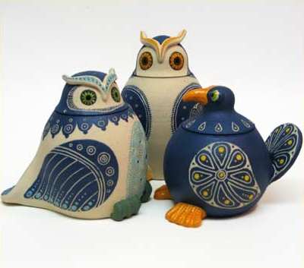
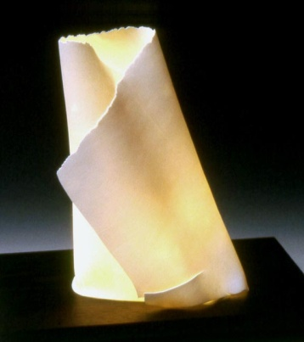
CERAMICS

Slide 2
What is Ceramics?
Ceramics – the art of using clay
Pottery & Sculpture – what you can make with clay

Slide 3
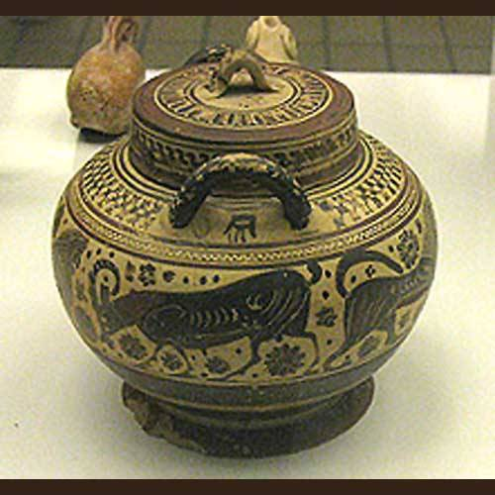
Why Pottery is so cool…
When pottery was first invented, it changed people’s lives!!
People now had a place to store their food, water and seeds. Food could stay more fresh and farming became more prominent as hunting dwindled down, ending the nomadic lifestyle.

Slide 4
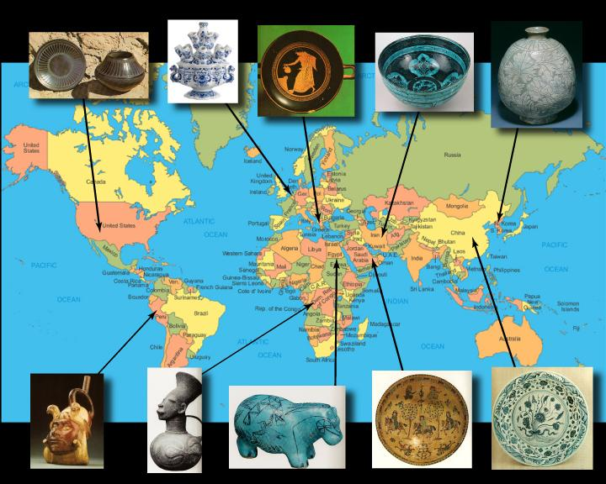
Ceramics Around the World
Ceramics have been used, throughout the world, for tens of thousands of years.
Archeologists have uncovered human-made ceramics in the form of animal and human figurines that date back to at least 24,000 BC.

Slide 5
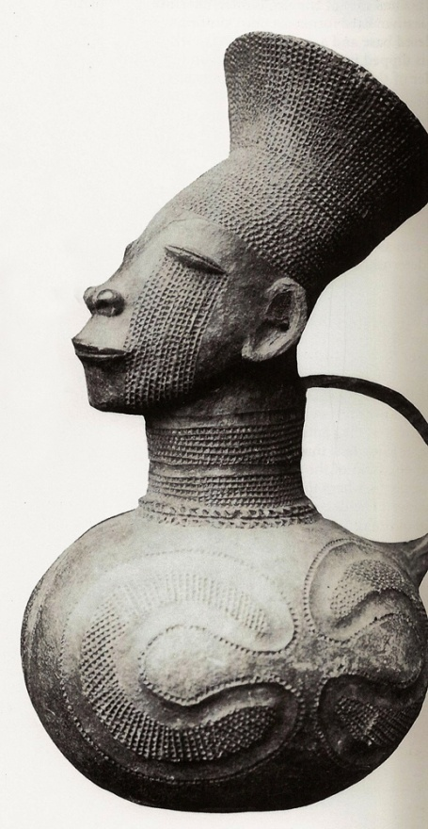
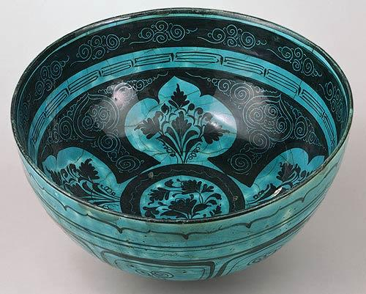
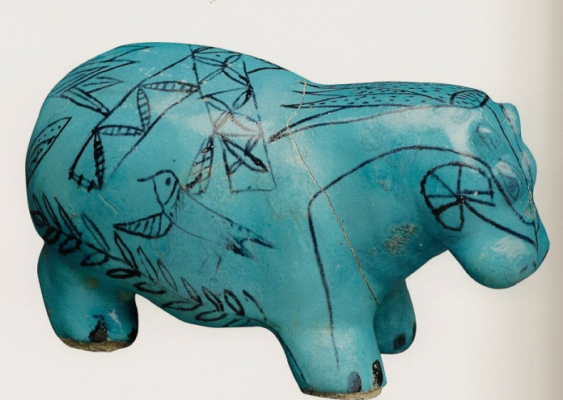
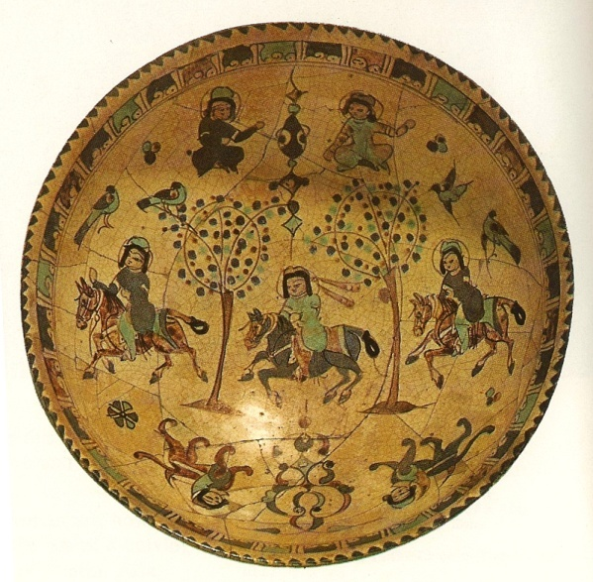
Examples of African and Middle Eastern Ceramics
Iran
Egypt
1800 BC
Democratic Republic
of Congo
Saudi
Arabia

Slide 6
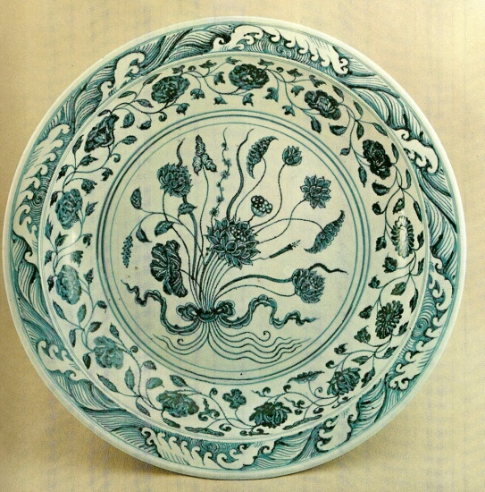
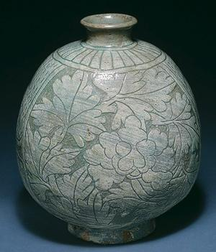
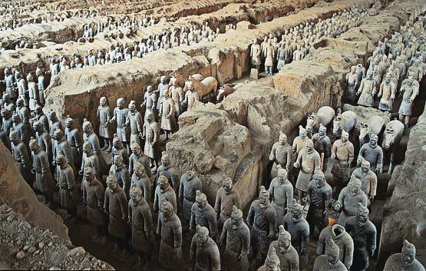
Examples of Asian Ceramics
China – Ming Dynasty
1300 AD
Korea
Terra Cotta Warriors
210 BC

Slide 7
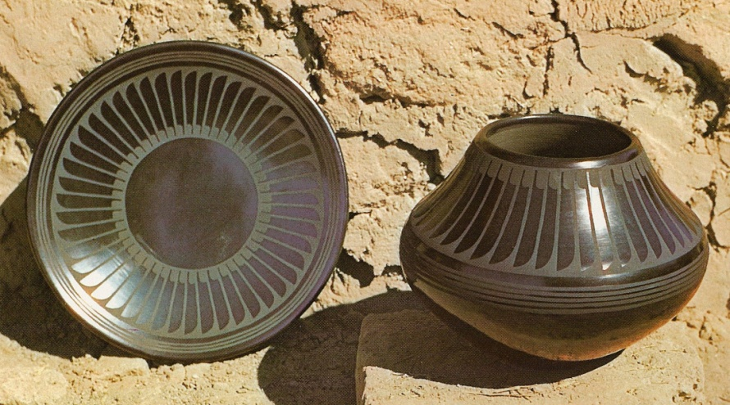
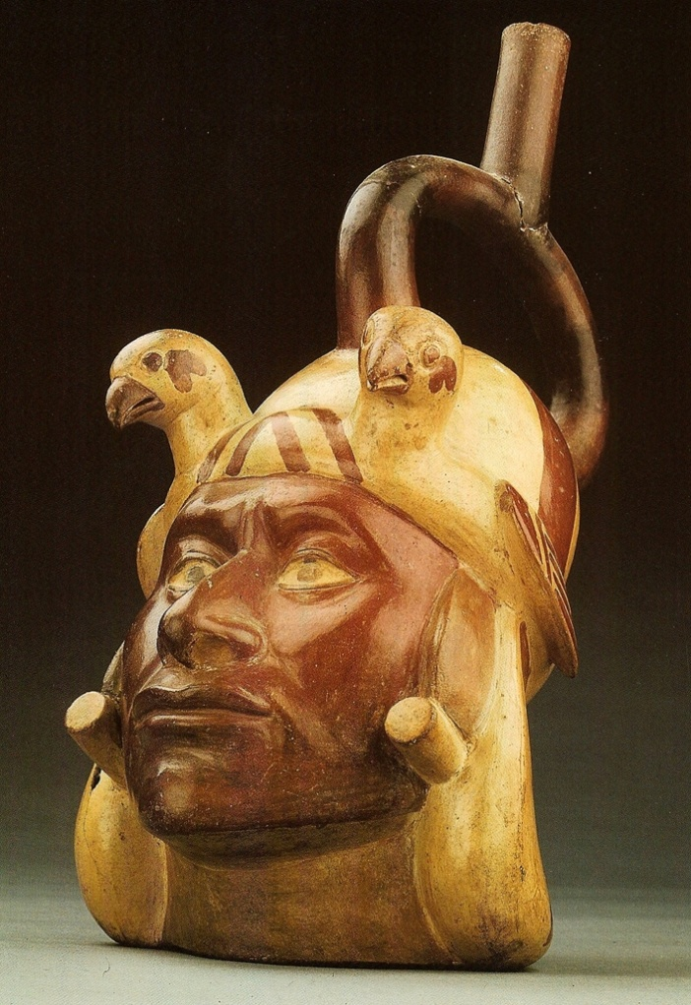
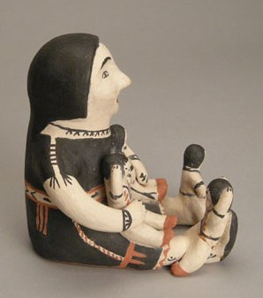
Examples of North and South American Ceramics
United States (Native American Pueblo)
Peru (Incan)
400 AD

Slide 8
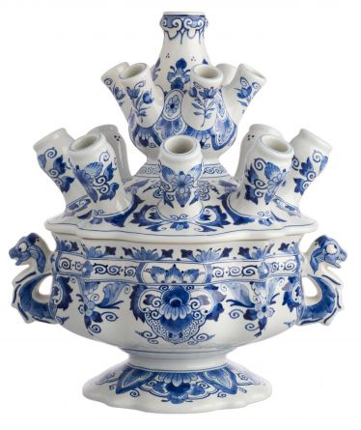
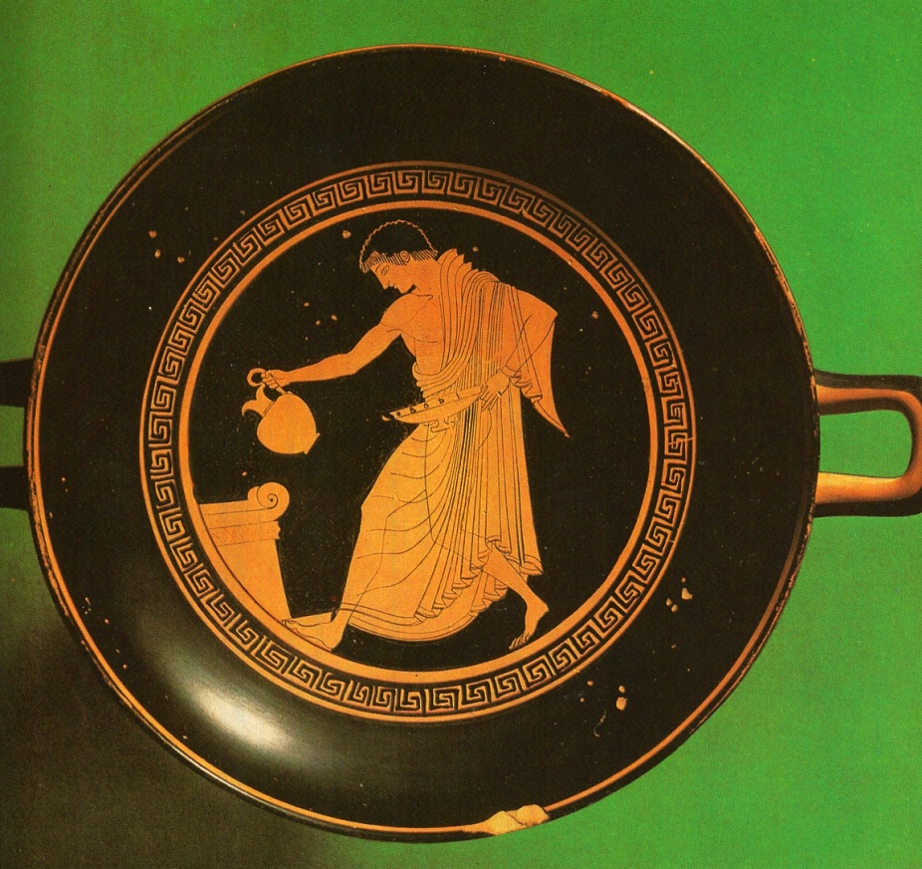
Examples of European Ceramics
Netherlands
(Delftware)
Greece

Slide 9
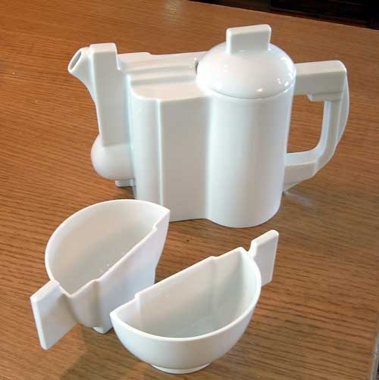
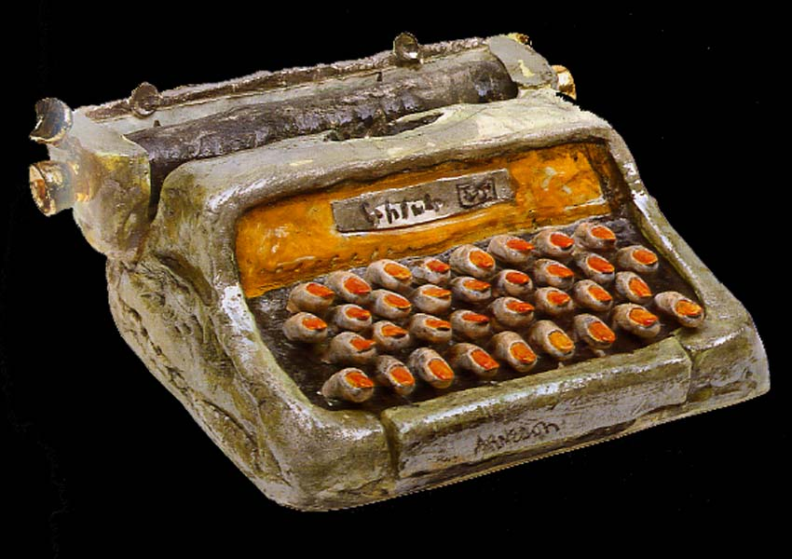
Examples of Contemporary Ceramics

Slide 10
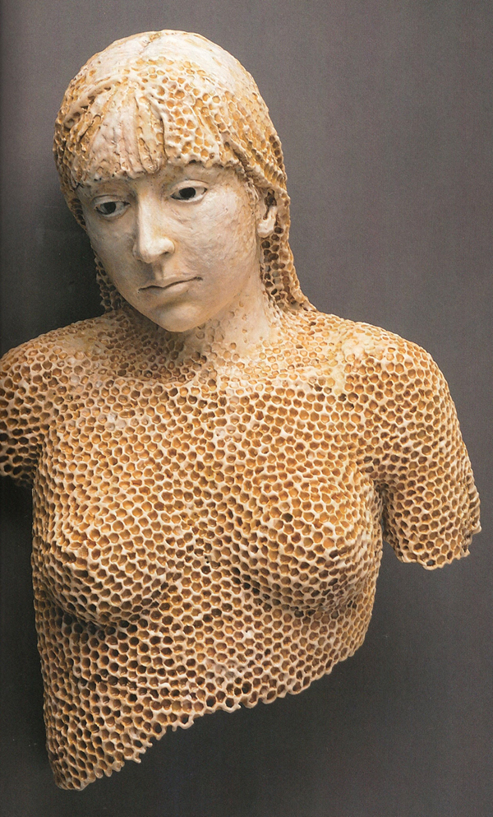
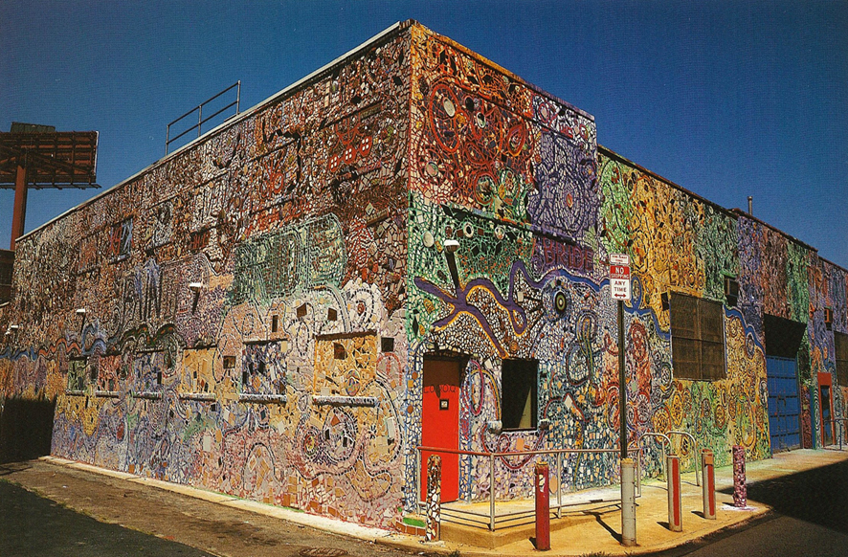
Examples of Contemporary Ceramics

Slide 11
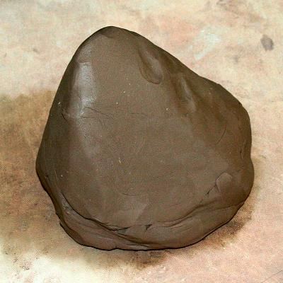
BASIC Materials
Why was clay available to all those civilizations??
Clay – made up of layers of sediment (basically, dirt and minerals) pressing into each other. The sediment is held together by water, making it like a solid mud. Depending on the minerals, the clay can be many colors – brown, gray, red, green & white

Slide 12
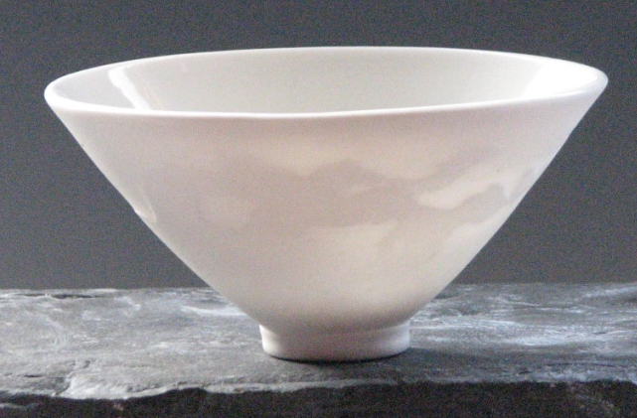
Common Types of Clay
Earthenware: clay fired at relatively low temperatures (1800°F-2100°F), often contains iron (red clay) and has a porous surface when fired
**this is the type we use @ HS
Stoneware: a buff, gray or brown clay which is heavy, opaque, and highly plastic in nature with a high firing temperature (2200°F-2400°F)
Porcelain: the finest white clay you can use…with a high firing temperature (2200°F-2550°F), is non-porous, strong, and translucent when fired

Slide 13
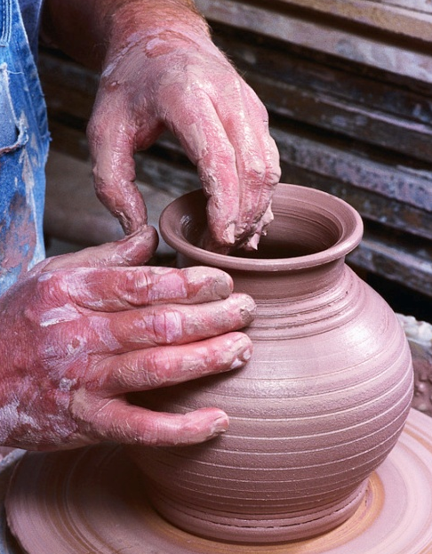
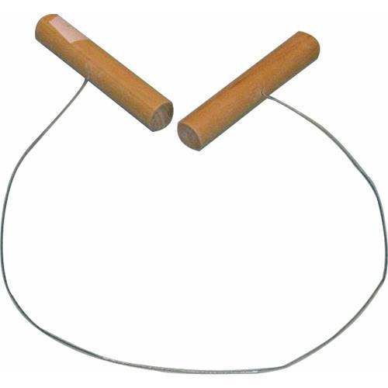
Tools, Tools, Tools….
hands
modeling tools / wood tools
loop tools
Rib tools
sponge
Wire/string clay cutter

Slide 14
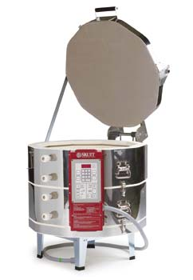
BASIC Materials
Kiln: a specially designed oven capable of reaching temperatures over 2000° F (can be electric, gas, or wood-fired)
We say: Clay projects are “fired” in the kiln

Slide 15
Clay Shaping Methods
Wheel Throwing
Slip Casting / Molds
Hand Building
Tile

Slide 16
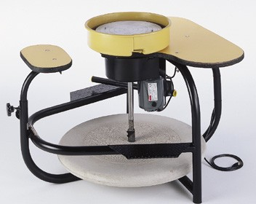
Wheel Throwing
Process of making clay sculptures using the centrifugal force of a spinning wheel.
Electric Wheel
“Throwing” is the term meaning to use/shape clay on the potter’s wheel
Kick Wheel

Slide 17
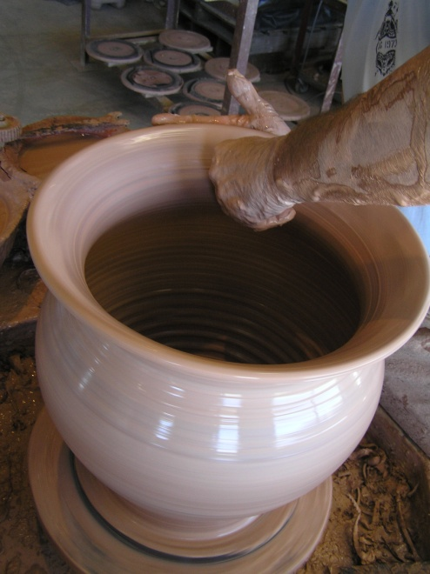
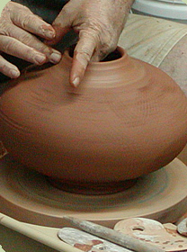
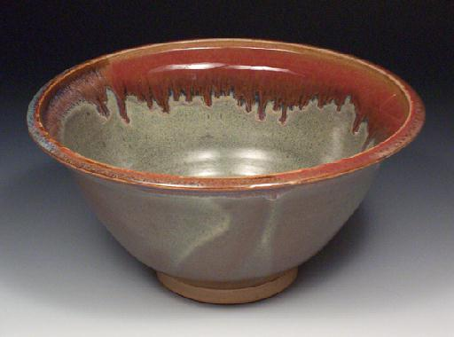
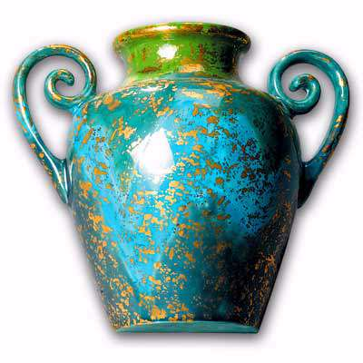
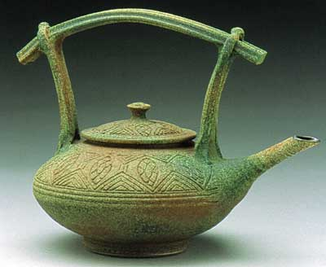
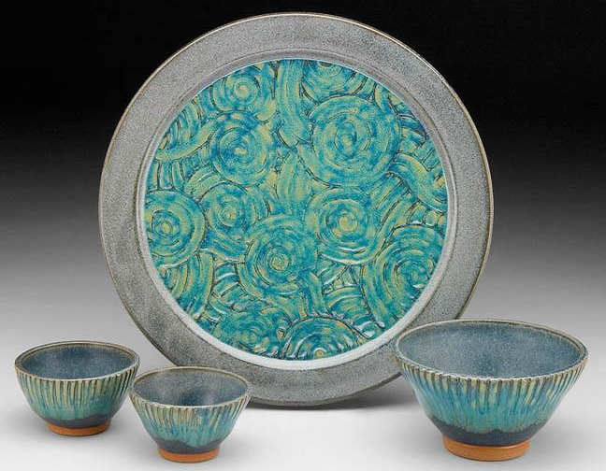
Wheel Thrown Pottery

Slide 18
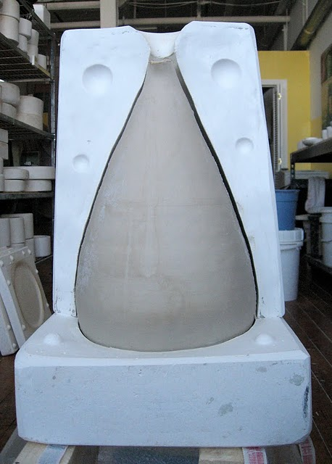
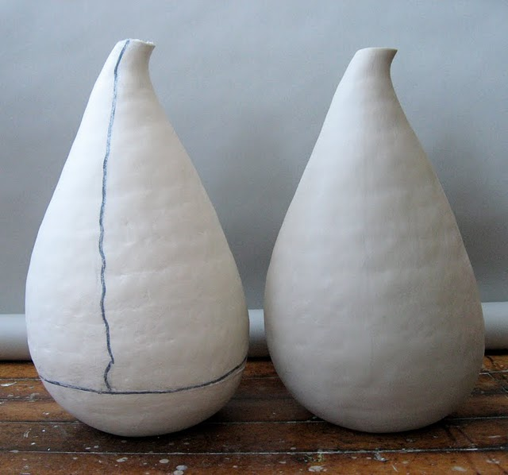
Slip Casting
Slip: a liquid mixture of clay and water…aka…slurry.
Casting: manufacturing process where a liquid material is poured into a mold

Slide 19
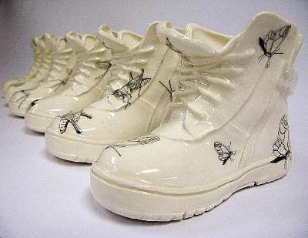
Slip Cast Ceramics

Slide 20
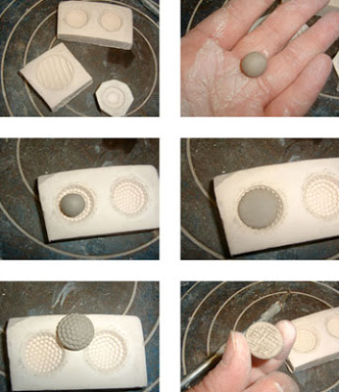
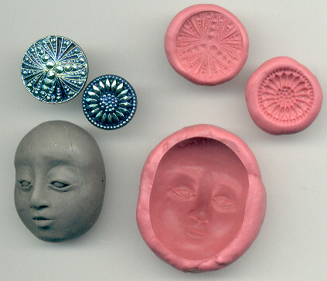
Molds
Press / Sprig Mold: shaping clay by pressing clay into a mold

Slide 21
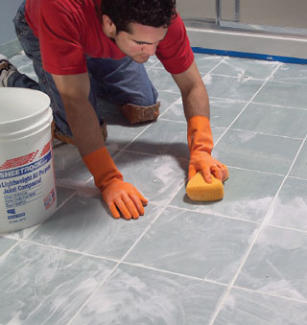
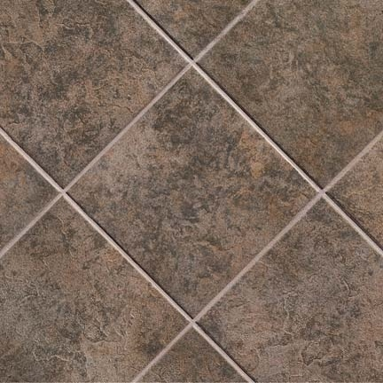
Ceramic Tile
To create art and cover surfaces by cementing and grouting glaze ware pieces together

Slide 22
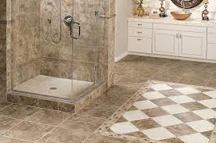
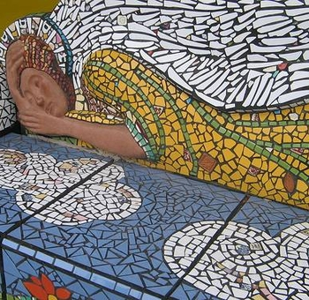
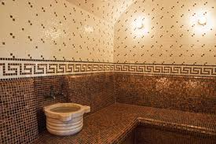
Ceramic Tile

Slide 23
Hand Building
Pinch Pot
Coil Construction
Slab Construction

Slide 24
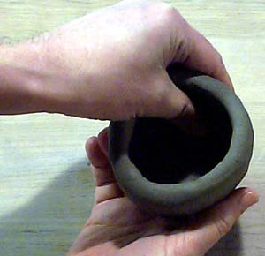
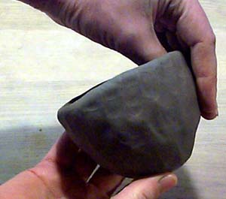
Pinch Pot
Pinching = squeezing clay with fingers to shape clay.
Making a pinch pot consists of pressing the thumb into a ball of clay, and drawing the clay out into a pot by repeatedly squeezing the clay between the thumb and fingers.

Slide 25
Pinch Pots

Slide 26
Coil Construction
Coils= snake-like rope-like pieces of clay that are used in making pottery.
It involves building the walls of a form with a series of coils into the required shape. The surface can either remain coil-textured or they can be smoothed.

Slide 27
Coil Ceramics

Slide 28
Slab Construction
Slab = evenly thick piece of clay.
Creating forms by joining slabs.

Slide 29
Slab Ceramics

Slide 30
Other terms:
Wedging / Kneading:
Process of removing air bubbles in clay and to ensure an even consistency of the clay. Must be done to all clay before working.
Wedging: Repeatedly throwing clay, gently at a flat surface.
Kneading: Folding clay into a lump, pushing forward then folding it over again, pushing air out the sides of the clay

Slide 31
Other terms:
Wet & Score:
Process of scratching marks into clay to roughen up the surface. Water is added to this roughed up area to create slip which acts like a glue to hold two pieces of clay together. This process MUST be done anytime two pieces of clay are joined.

Slide 32
Other terms:
Extruding: like using a pasta maker…pushing clay through a shape
Incising: carving shapes/holes out of a piece of clay

Slide 33
Other terms:
Modeling: building up of soft material to make a sculpture
Carving: removing unwanted clay with tools to shape sculpture

Slide 34
Stages of Clay - Facts
Clay begins to dry when air touches the surface, causing water to evaporate.
Wrapping wet clay in plastic is the best way to keep from drying out. If projects are to be left for more than 1-2 days, a small wet paper towel may be added inside the plastic bag to keep inside of bag moist.
When clay dries, it shrinks up to 13% of its original size.

Slide 35
Stages of Clay
Plastic: soft/pliable clay. Best for building/modeling
Leather hard (Greenware): clay is dry enough to maintain form but can still be smoothed, carved, and added to
Bone dry (Greenware): clay has dried as much as possible before first firing and is extremely brittle / fragile!!

Slide 36
Stages of Clay
Bisque (Bisqueware): first firing where all remaining water molecules are released from the clay transforming it into ceramic (Why are air bubbles dangerous during a bisque fire?)
Glazed (Glazeware): second firing where glaze has melted onto the ceramic surface making it non-porous / waterproof

Slide 37
Timeline of clay body...
Plastic Stage (Building)
Leather hard
Bone Dry
1st Firing (Bisque Firing)
Bisque ware
2nd Firing (Glaze Firing)
Glaze ware!!

Slide 38
Decorating Methods
Stain: raw pigments, can be water or acrylic based
Burnishing: rearranging and compressing clay particles by rubbing the surface of a clay object until it becomes glossy
Glaze: a glass coating that is specially made to stick onto ceramic surfaces
Under glaze: colored slips applied beneath a glaze layer

Slide 39
Clean-Up
Hazards of clay dust:
Silica particles = extremely tiny pieces of glass, which became airborne and easily inhaled….extremely hazardous to lungs
Solution:
WET clean-up prevents dust from building up and becoming airborne
Use wet sponges, spray bottles, wet paper towel

